Slide 1
JUnit:
Testing code as you write it
Created By: DoanPT1

Slide 2
Content
Why do we need test and why we need testing framework?
What JUnit? Why Junit? Why JUnit5?
JUnit 5 Architecture
Create project, sample test and run tests?
Method naming in Junit
Display or Blackticks annotation
JUnit assertion methods
JUnit Lifecycle
TestInstance annotation
Condition Excutions
Assumptions
Repeated Tests
Parameterized Test
Nested Test
Disable annotation
Tag annotation
Test Suite
Why we need mock? Basic mock concept.
Mockito Framework
MockK Framework
References and Assigment

Slide 3


Why do we need test?
Design
Write code
Test(Manual) Do everytime
Design
Write code
Writing tests
Run the Tests
Can ReUse

Slide 4
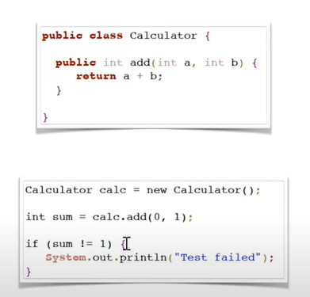
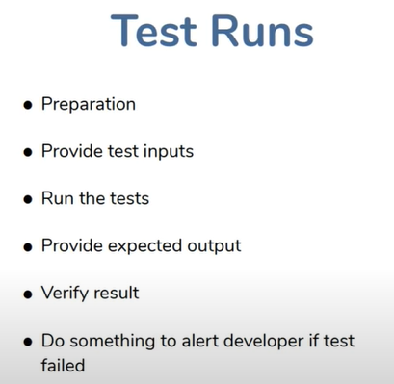
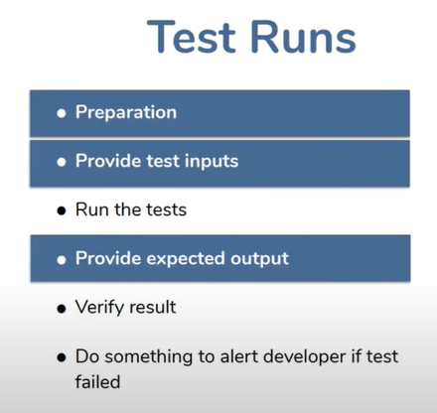
Why do we need a testing framework?
No Testing Framework
Have Testing Framework

Slide 5
What is JUnit?
●
JUnit is an open source framework that has been designed for the purpose of writing and running tests in the Java programming language.
Originally written by Erich Gamma and Kent Beck. There are many ways to write test cases.
●

Slide 6
Why Use JUnit?
●
JUnit provides also a graphical user interface (GUI) which makes it possible to write and test source code quickly and easily.
To write and run repeatable tests.
Programmers normally write their code, then write tests for it. Better to write tests while writing code.
JUnit provides a framework to keep tests small and simple to test specific areas of code.
JUnit shows test progress in a bar that is green if testing is going fine and it turns red when a test fails.
We can run multiple tests concurrently. The simplicity of JUnit makes it possible for the software developer to easily correct bugs as they are found.
●
●
●
●
●

Slide 7
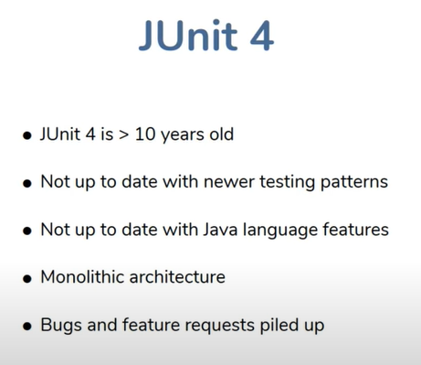
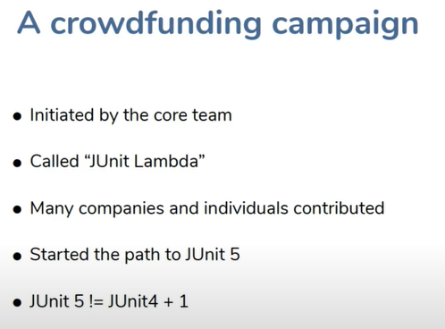
Why JUnit5 but not JUnit4?
JUnit5 It’s is whole new things.
It requires changes to the way you write code!

Slide 8
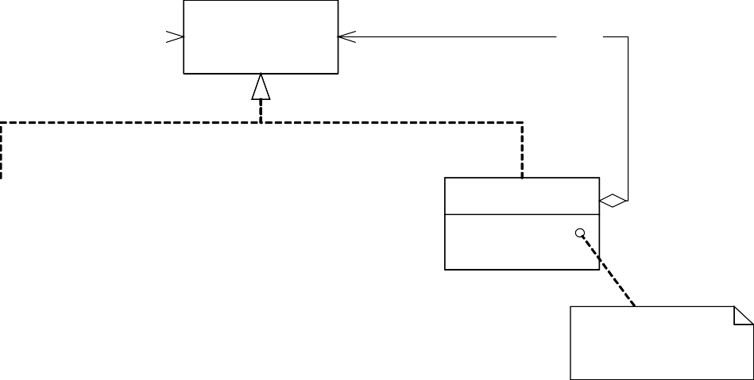
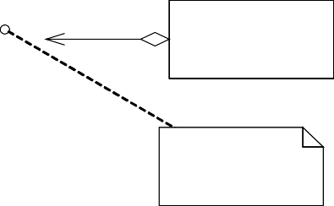
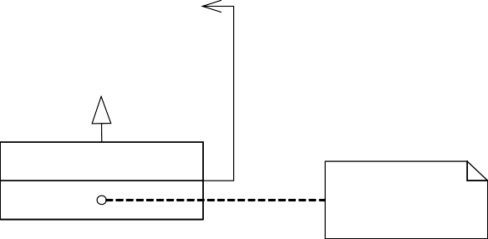
JUnit framework
Testing client
Test
fTests
TestCase
TestSuite
run(TestResult) setUp() runTest() tearDown()
TestResult
run(TestResult) addTest(Test)
setUp() runTest() tearDown()
forall test in fTests test.run(TestResult)
ConcreteTestCase
TestedClass
setUp() runTest() tearDown() test1() test2()
action()
fName
runTest()
test1() or test2()

Slide 9
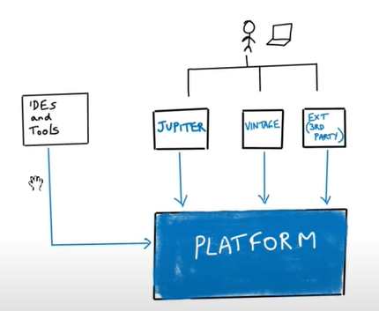
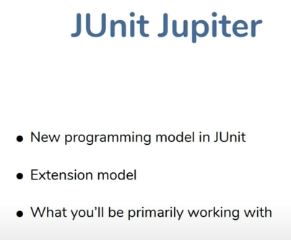
Junit 5 Architecture
Notes:
-Platform is whole things to write and run junit code, it’s contain bunch of those things are a part of core platform, Developer does not interact directly with it.
-Jupiter new name of Junit, It does not want to called as a API same with Junit 4, it named jupiter due to jupiter is fifth planet in the solar system and this is Junit 5
Jupiter is what the thing we interact while we write the code
-Vintage is another set of apis that you use when you running older junit test
3rd party extension, you don’t want to use Junit api, you can come with your own api and still use core test engine to run your test
- IDE and tools use platform directly to run your code

Slide 10
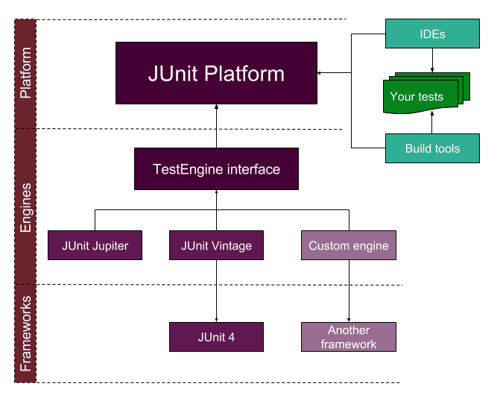
Junit 5 Architecture
Notes:
-Platform is whole things to write and run junit code, it’s contain bunch of those things are a part of core platform, Developer does not interact directly with it.
-Jupiter new name of Junit, It does not want to called as a API same with Junit 4, it named jupiter due to jupiter is fifth planet in the solar system and this is Junit 5
Jupiter is what the thing we interact while we write the code
-Vintage is another set of apis that you use when you running older junit test
3rd party extension, you don’t want to use Junit api, you can come with your own api and still use core test engine to run your test
- IDE and tools use platform directly to run your code

Slide 11
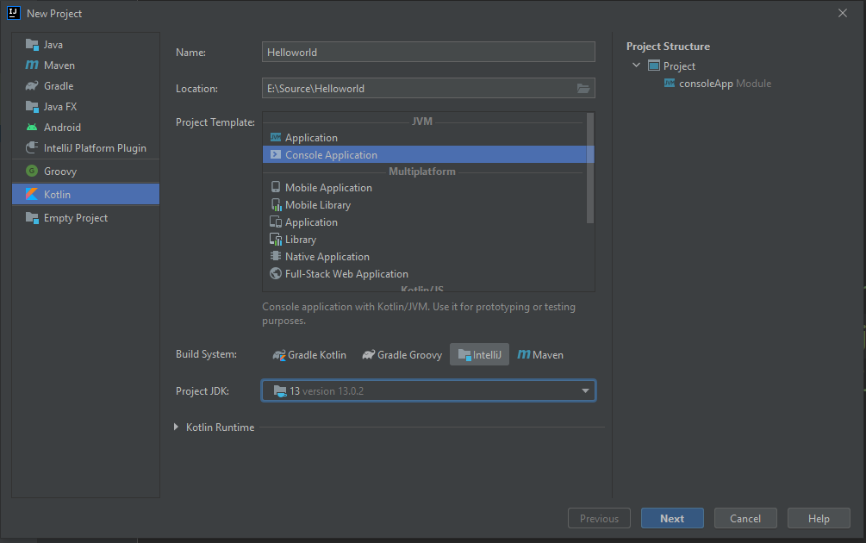
Create a new project
Open Intelji and click File-> New Project

Slide 12
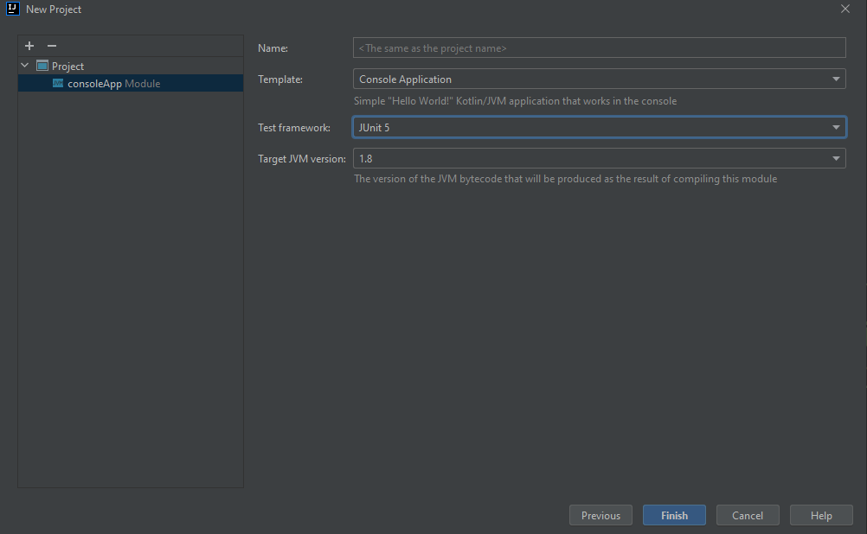
Create a new project
Selecte Junit 5 as Test framework then click Finish

Slide 13
Create a Junit test
import org.junit.jupiter.api.Test;
class ClassName {
@Test
fun testName() { // a test case method
...
}
}
A method with @Test is flagged as a JUnit test case.
All @Test methods run when JUnit runs your test class.
Coding Convention for JUnit Class
Name of the test class must end with "Test".
Name of the method must begin with "test".
Return type of a test method must be void.
Test method must not throw any exception.
Test method must not have any parameter.

Slide 14
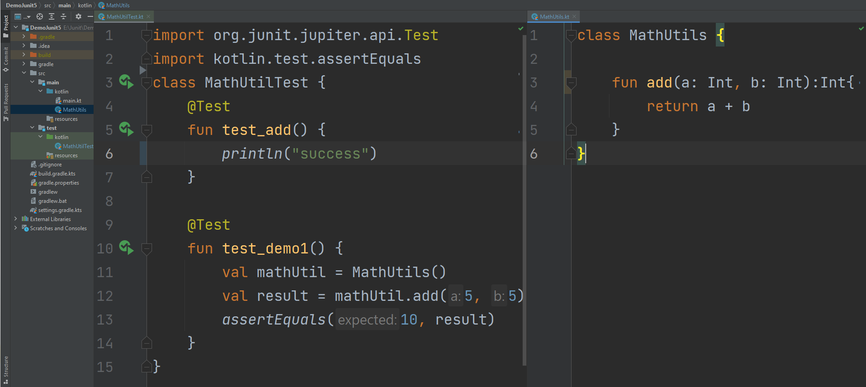
Create a Junit test

Slide 15
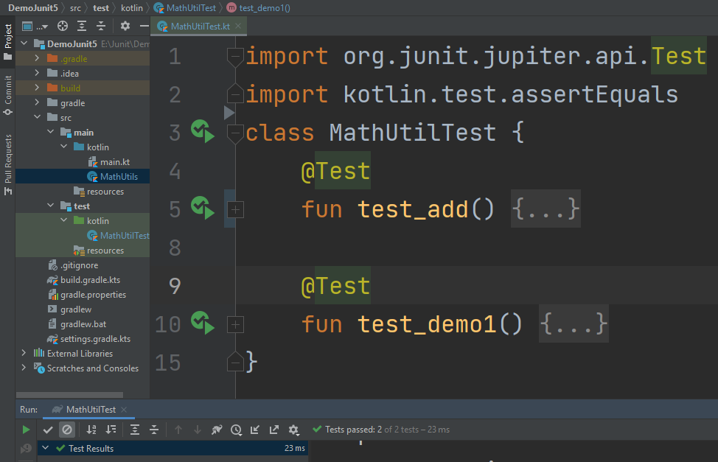
Run the tests
Run all test in this class
Run the specific test
Ouput and actions

Slide 16
Method naming in Junit
MethodName_StateUnderTest_ExpectedBehavior
Ex: isAdult_AgeLessThan18_False
MethodName_ExpectedBehavior_StateUnderTest
Ex: isAdult_False_AgeLessThan18
test[Feature being tested]
Ex:testIsNotAnAdultIfAgeLessThan18
Feature to be tested
Ex:IsNotAnAdultIfAgeLessThan18
Should_ExpectedBehavior_When_StateUnderTest
Ex: Should_ThrowException_When_AgeLessThan18
When_StateUnderTest_Expect_ExpectedBehavior
Ex:When_AgeLessThan18_Expect_isAdultAsFalse
Given_Preconditions_When_StateUnderTest_Then_ExpectedBehavior
Ex:Given_UserIsAuthenticated_When_InvalidAccountIsUsed_Then_TransactionsWillFail
For more details: https://github.com/doanpt/Junit-tutorial/commit/5f020f5

Slide 17
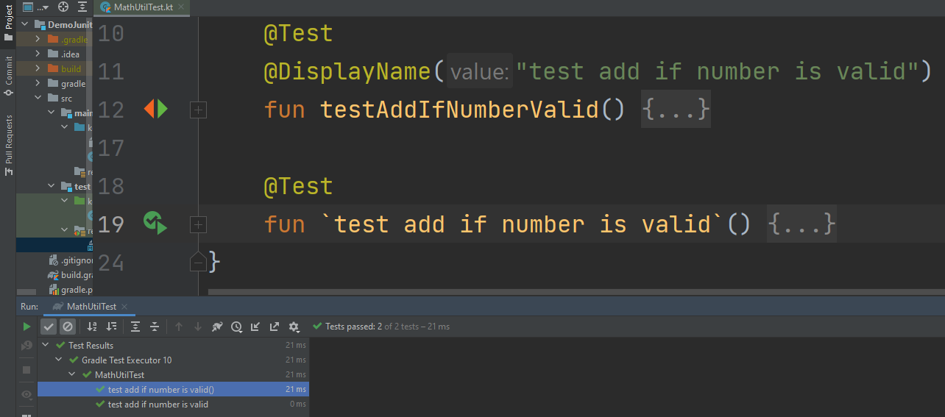
Displayname annotation or backticks
We can use DisplayName annotation or Backticks to highly improves readability.

Slide 18
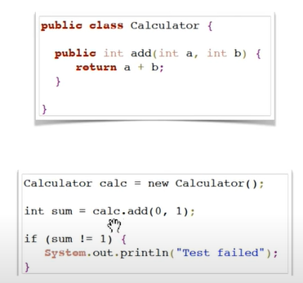
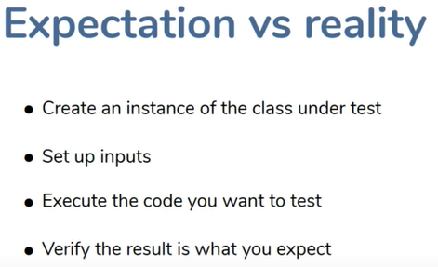
JUnit assertion methods
Why do we need assertion methods?

Slide 19
JUnit assertion methods
JUnit provide many assertion method as below:
assertTrue(test) | fails if the boolean test is false
assertFalse(test) | fails if the boolean test is true
assertEquals(expected, actual) | fails if the values are not equal
assertSame(expected, actual) | fails if the values are not the same (by ==)
assertNotSame(expected, actual) | fails if the values are the same (by ==)
assertNull(value) | fails if the given value is not null
assertNotNull(value) | fails if the given value is null

Slide 20
JUnit assertion methods
assertThrows<exception.class> {executable} | Check if executable throw exception
assertAll(list of assertions) | check multiple assertions
assertTimeout(timeout, executable) | set maximal execution time
fail() | causes current test to immediately fail
So on...
Each method can also be passed a string to display if it fails:
e.g. assertEquals(expected, actual, "message")
There is a “fail” method so Why is there no “pass” method?

Slide 21
JUnit Excercise
Given a Date class with the following methods:
Date(int year, int month, int day)
fun getDay(), getMonth(), getYear():Int
fun addDays(int days)// advances by days
fun daysInMonth(): Int
fun equals(Object o): Boolean
fun toString(): String
Come up with unit tests to check the following:
That no Date object can ever get into an invalid state.
That the addDays method works properly.
Notes:
a good equals method has some initial checks like checking for null, checking whether this == that, check instanceof, etc... then it calls compareTo

Slide 22
What's wrong with this?
class DateTest {
@Test
fun test1() {
val d = Date(2050, 2, 15);
d.addDays(4);
assertEquals(d.getYear(), 2050);
assertEquals(d.getMonth(), 2);
assertEquals(d.getDay(), 19);
}
@Test
fun test2() {
val d = new Date(2050, 2, 15);
d.addDays(14);
assertEquals(d.getYear(), 2050);
assertEquals(d.getMonth(), 3);
assertEquals(d.getDay(), 1);
}
}

Slide 23
Well-structured assertions
class DateTest {
@Test
fun test1() {
var d = Date(2050, 2, 15);
d.addDays(4);
assertEquals(2050, d.getYear()); // expected
assertEquals(2, d.getMonth()); // value should
assertEquals(19, d.getDay()); // be at LEFT
}
@Test
fun test2() {
var d = new Date(2050, 2, 15);
d.addDays(14);
assertEquals(2050, d.getYear(), "year after +14 days");
assertEquals(3, d.getMonth(), "month after +14 days);
assertEquals(1, d.getDay(), "day after +14 days");
} // test cases should usually have messages explaining
} // what is being checked, for better failure output

Slide 24
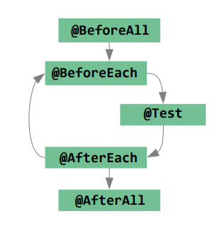
JUnit Lifecycle

Slide 25
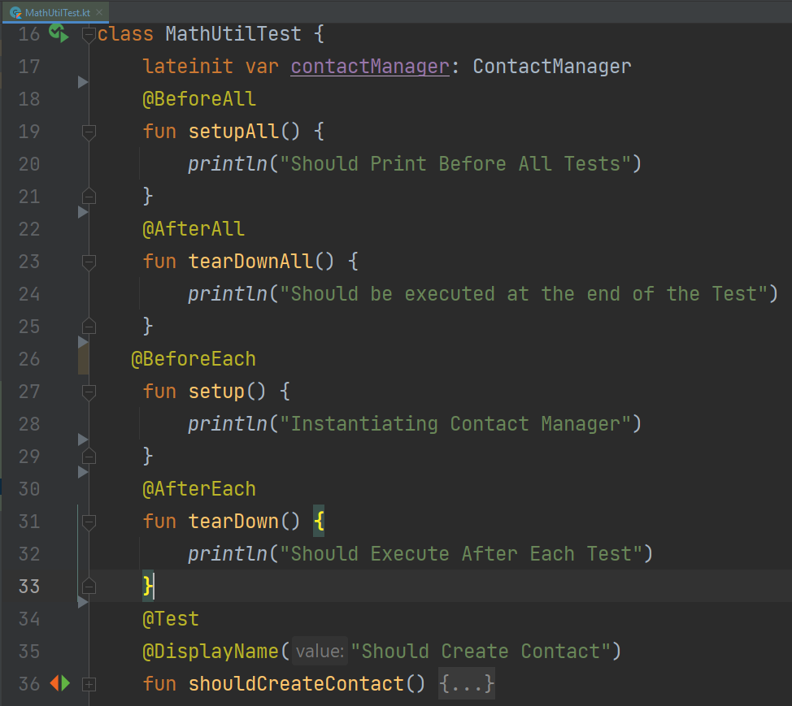
JUnit Lifecycle
JUnit will create a instance for each test, so BeforeAll and AfterAll must be static method

Slide 26
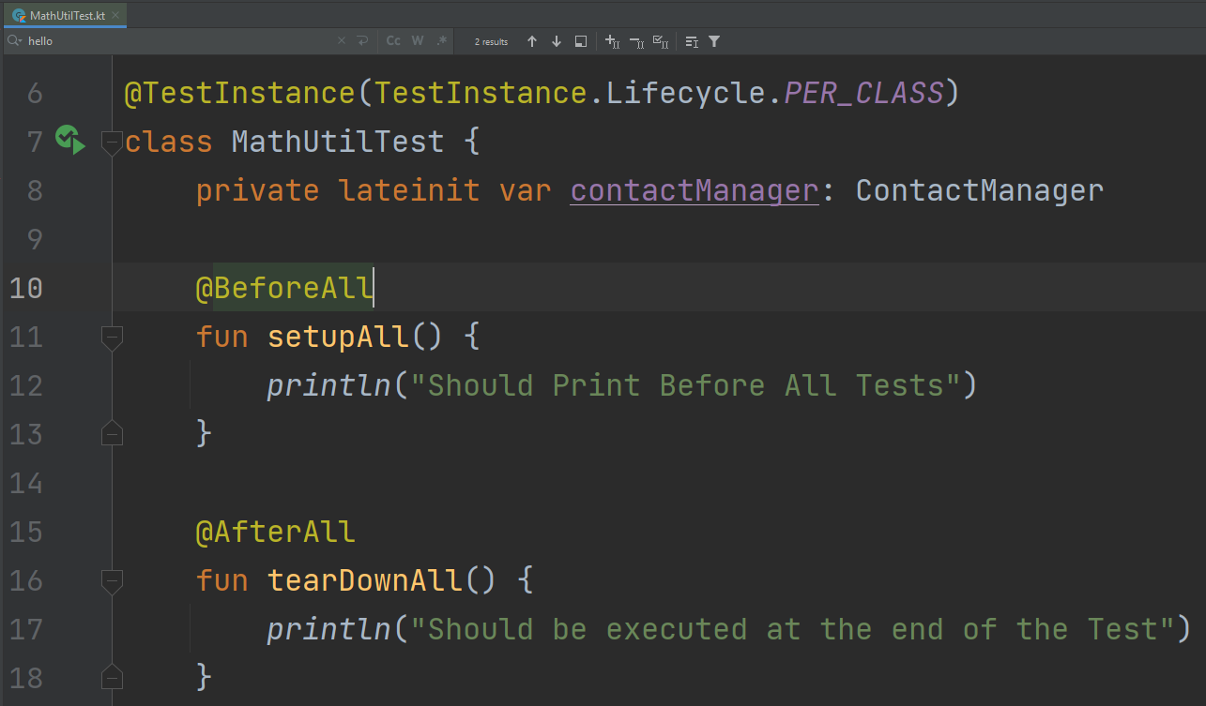
TestInstance annotation
Test Instance annotation will tell JUnit create only once instance for a test class, so we don’t need static for BeforeAll and AfterAll function

Slide 27
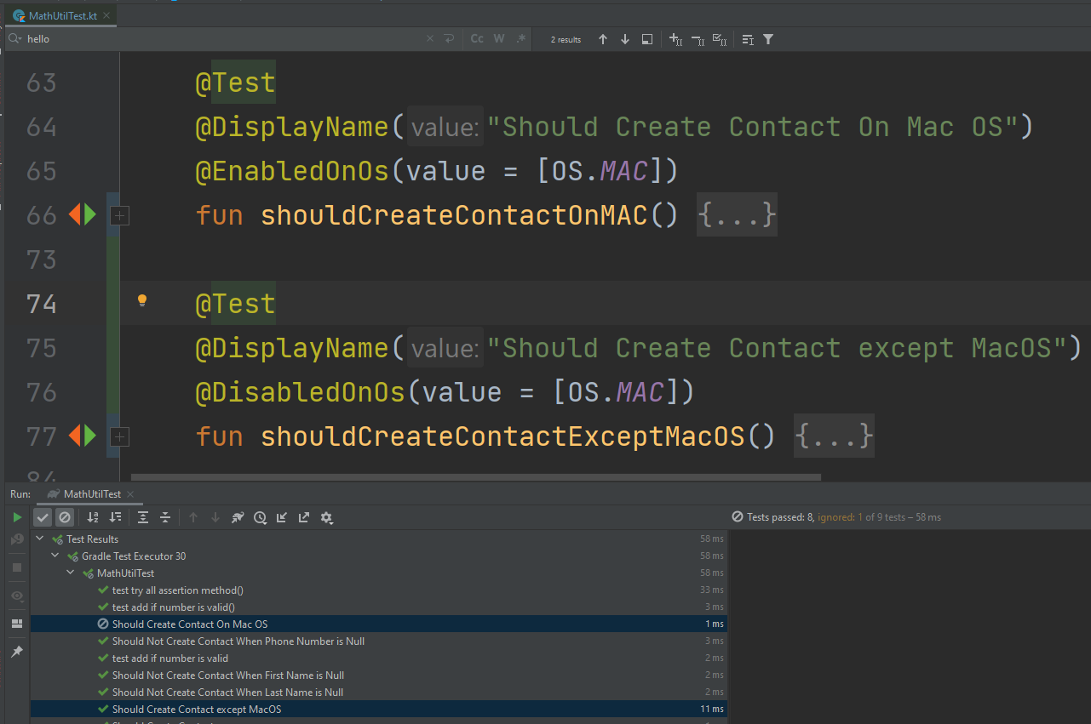
Condition Executions
We can run tests on specific OSs only. With 2 annotation: EnabledOn... And DisableOn...

Slide 28
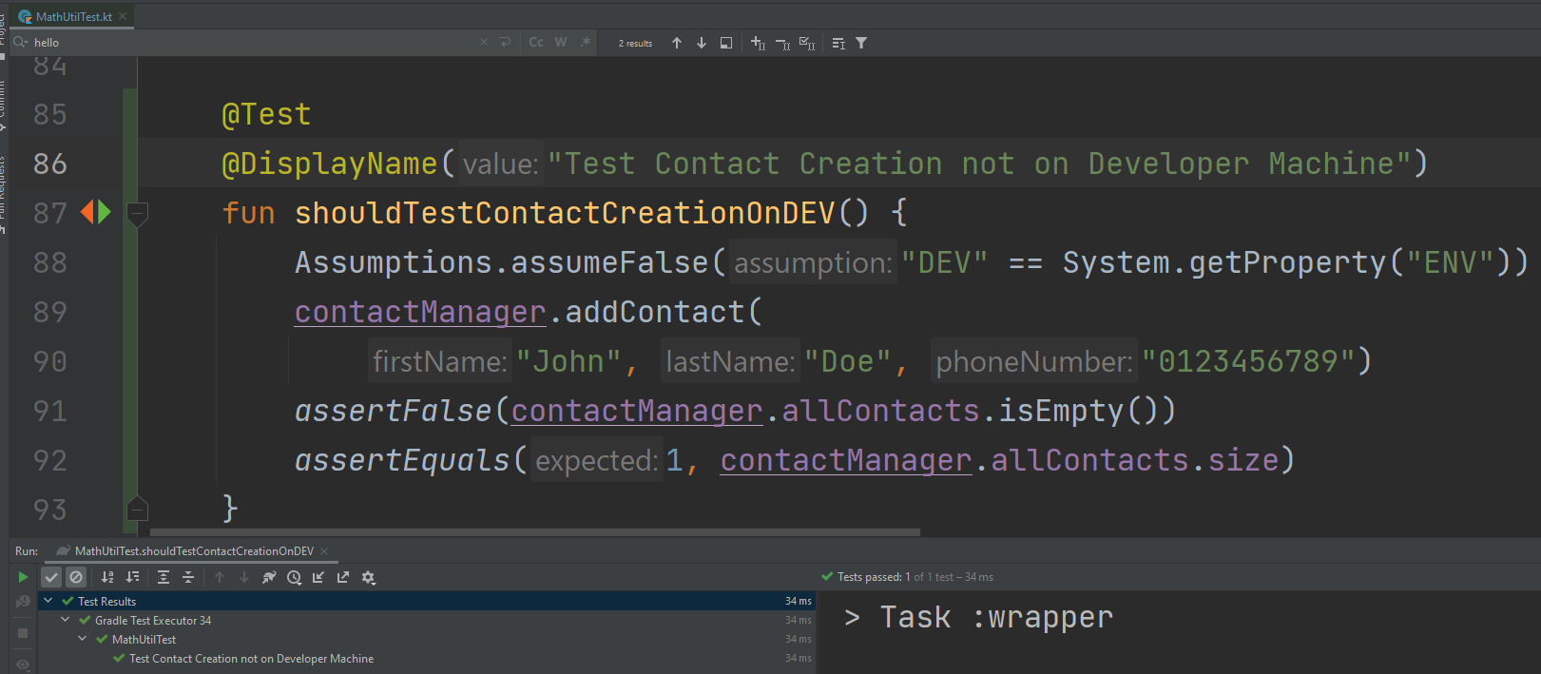
Assumptions
There may be particular test cases you want to make sure that you are running based on certain conditions.
You can have some test cases which should be executed on any Environment except Developer

Slide 29
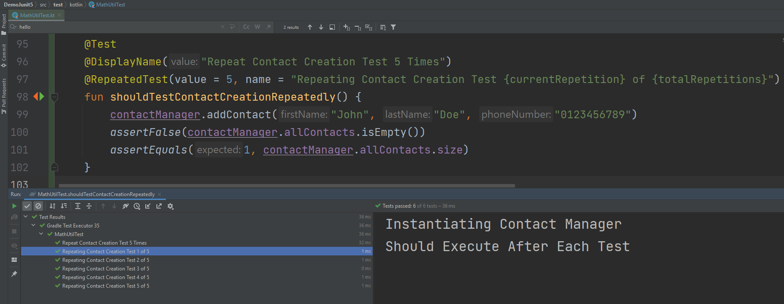
Repeated Tests
If you have any functionality which has some randomness to it, you may want to create and run that test multiple times, to make sure that the functionality is working as expected.
Junit 5 provides us the @RepeatedTest annotation to fulfil this requirement

Slide 30
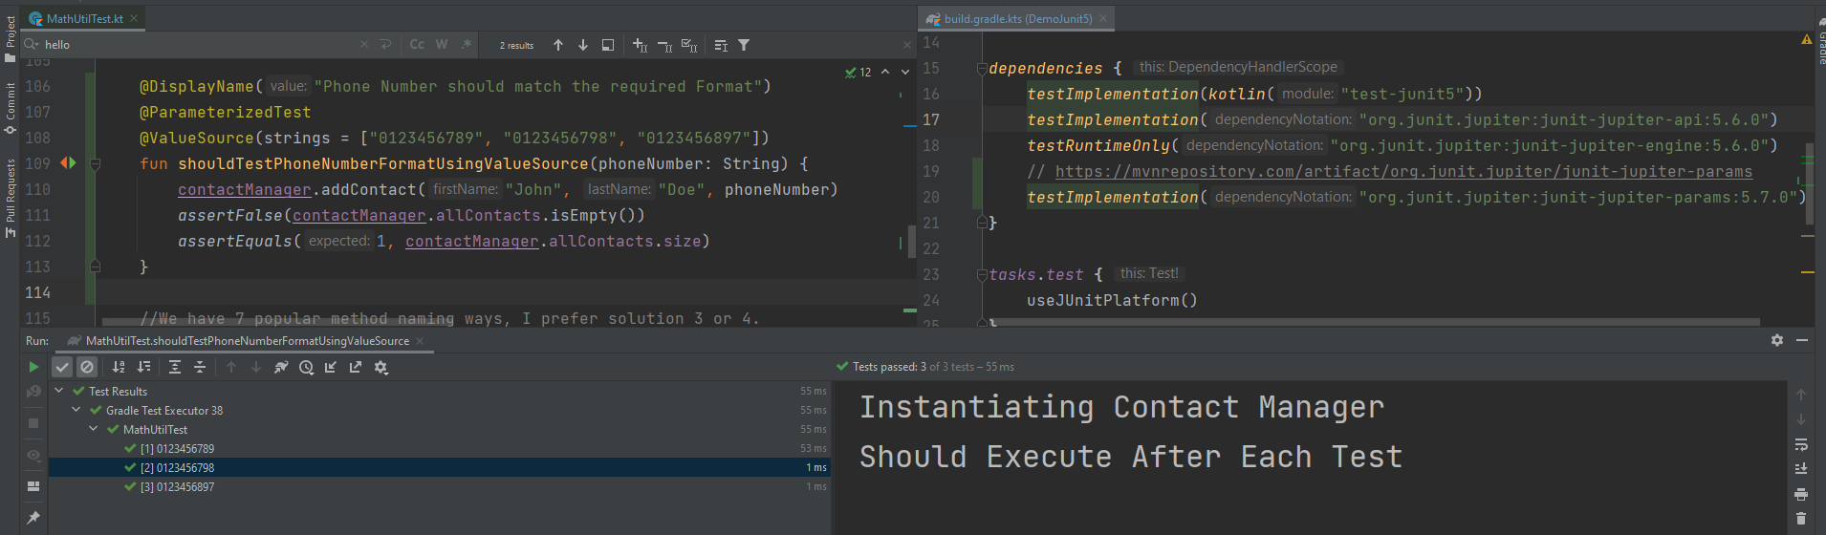
Parameterized Test
You can provide input to the Parameterized Test using the @ValueSource annotation
where you can provide a set of string, long, double, float literals to our test.
Eg: @ValueSource(strings = {“string1″,”string2″,”string3”})
Then you can access this string inside the test by first adding a String parameter to our test.

Slide 31
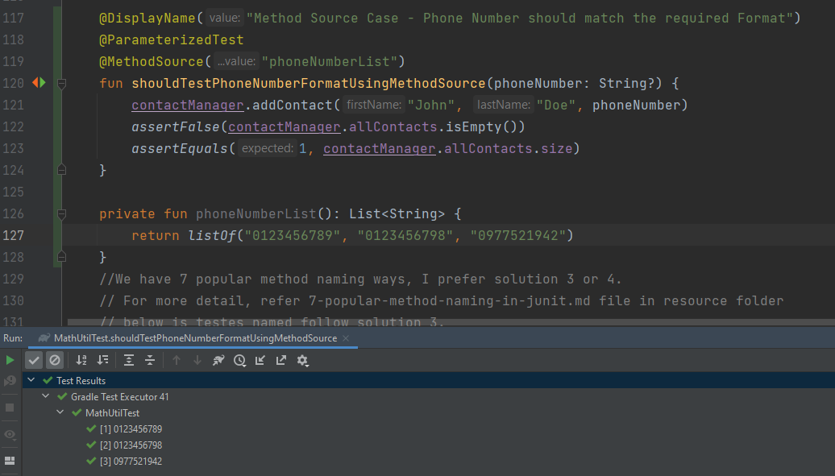
Parameterized Test
We can also use @MethodSource annotation to provide the input to our Parameterized Tests, using this annotation we will refer the method name which returns the values required for our tests as output.

Slide 32
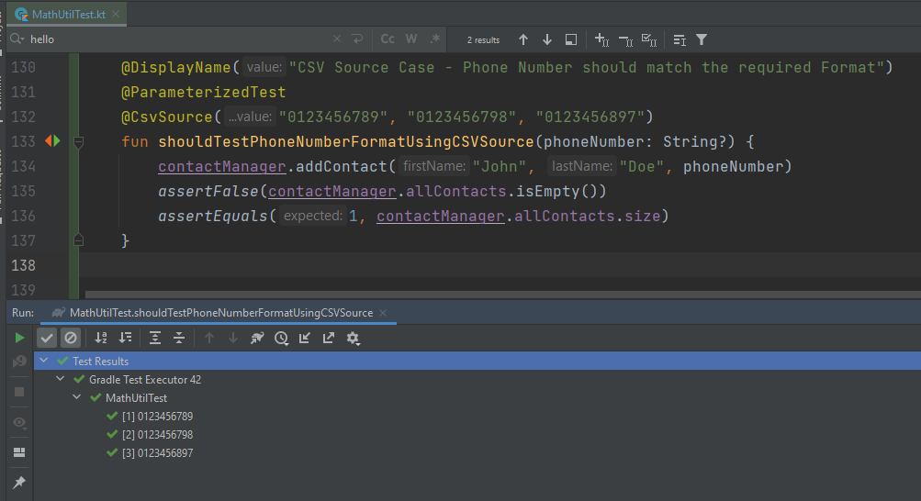
Parameterized Test
You can create an inline CSV which contains the input for the test and reference that using the @CsvSource annotation.

Slide 33
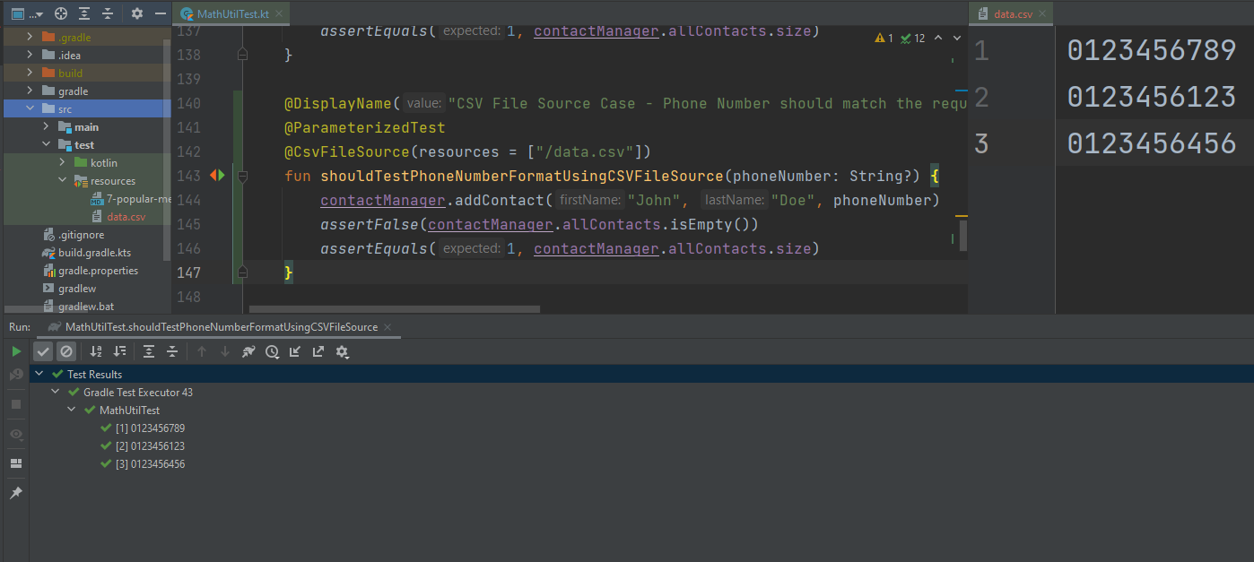
Parameterized Test
You can also reference a CSV File by using the @CsvFileSource annotation.
Note: All ParameterizedTest annotation does not contain Test Annotation in same method

Slide 34
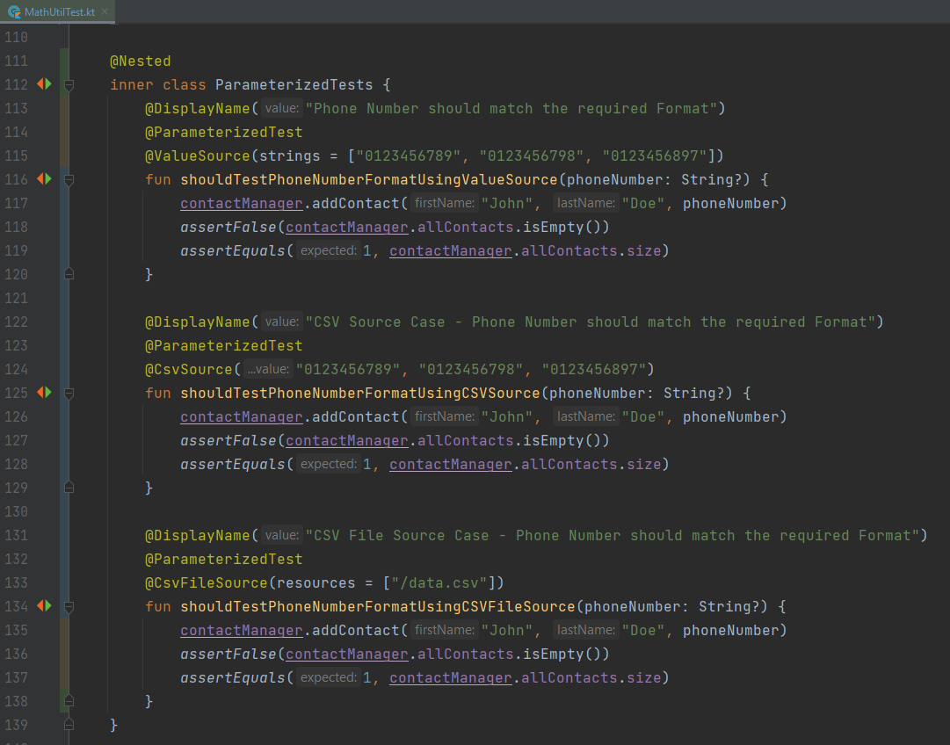
Nested Test
By now, you may have observed that our ContactManagerTest contains lots of test methods, we can organize these tests into Nested Tests using the @Nested annotation.
We are going to take a group of Tests and organize them into a seperate category of tests by creating a class and adding the @Nested annotation to it.

Slide 35
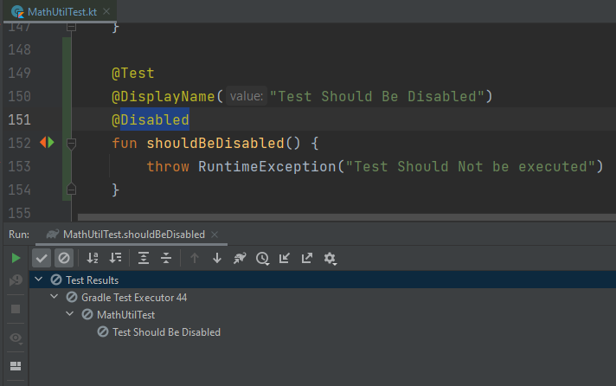
Disable
You can disable some tests from running by adding the @Disabled annotation.

Slide 36
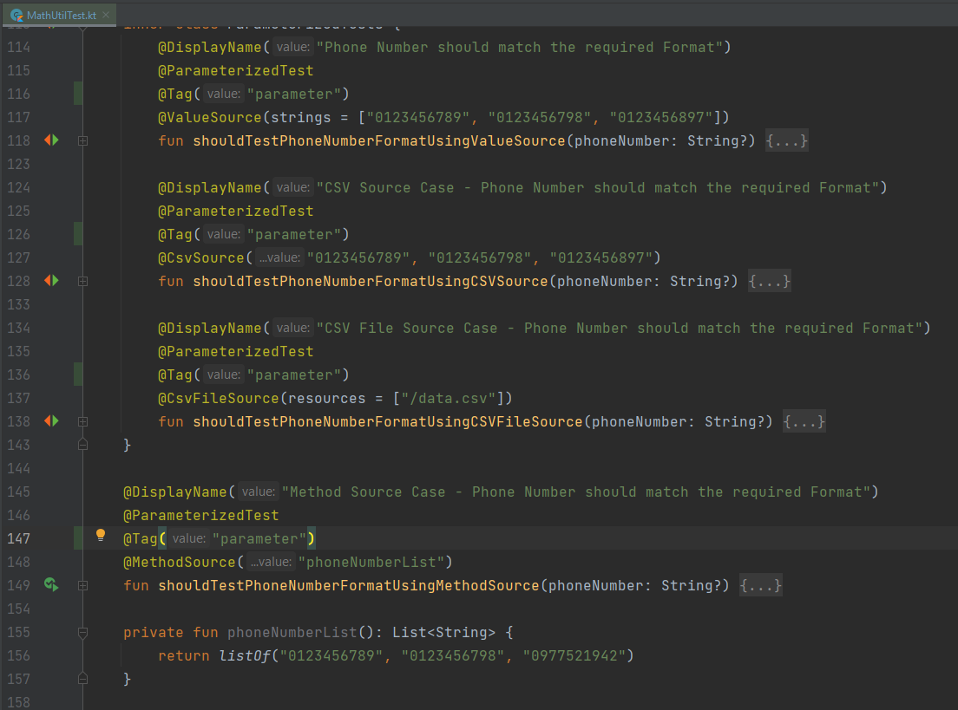
Tagged Tests
We can use Tag annotation to group tests that you want to run together.

Slide 37
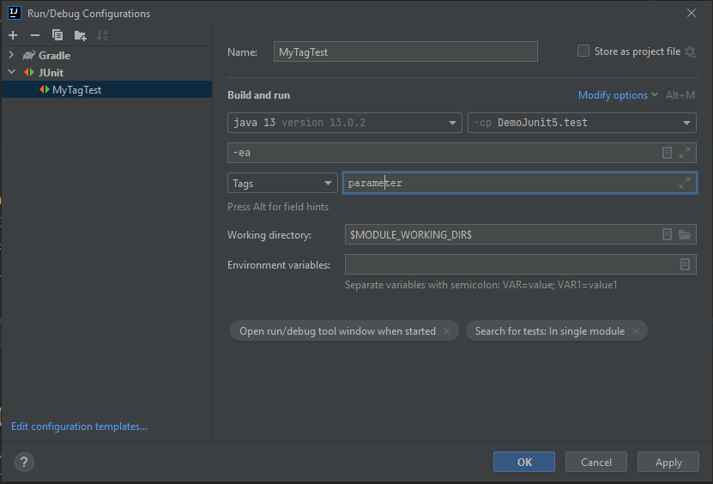
Tagged Tests
Then you need to add tags into run configuration

Slide 38
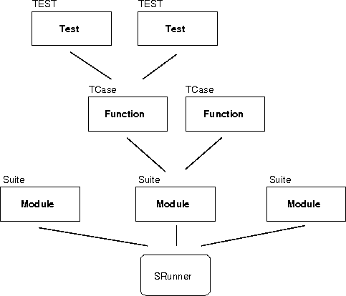
Test suites
●
In practice, you want to run a group of related tests
(e.g. all the tests for a class).
To do so, group your test methods in a class which extends TestCase.
Running suites we will see in examples.
●
●

Slide 39
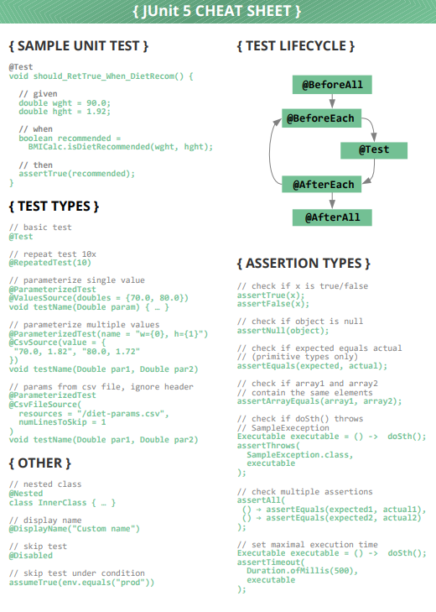
JUnit5 Cheat sheet

Slide 40
Why we need mock
• The JUnit testing framework, makes the testing of an independent, non-void method, simple.
➔But... how do we test an method with no return value?
➔How do we test a method that interacts with other domain objects?
Notes:
https://www.baeldung.com/kotlin/mockito
https://github.com/doanpt/Junit-tutorial

Slide 41
In Real-Life Units are NOT Totally Self Contained
• Dependencies – In order for a function to run it often requires Files, DB, JNDI or generally – other units
• Side effects – As a function runs we are often interested in data written to files, saved to db or generally – passed to other units
How can we test a single unit, without being affected by other units – their errors, set-up complexities and performance issues?
Notes:
https://www.baeldung.com/kotlin/mockito
https://github.com/doanpt/Junit-tutorial

Slide 42
What is a Stub?
A Stub is a test-only object which:
• Implements the same interface as the production object
• Gives the set of services used by the tested unit – often using a naïve, hard-coded implementation
More complex stubs may even contain test-supporting logic, e.g. assert that they are used correctly

Slide 43
Mock Objects
A Mock object is an object that:
• Is created by the mock framework
• Implements the same interface as the original dependent object. Otherwise, the compiler won’t let us pass it to the tested object.
• Supplies the tested code with everything it expects from the dependent object.
• Allows us to check that the tested code is using the dependent object (the Mock) correctly.

Slide 44
Use Mock object
To use a Mock object we should:
• Create instance of the Mock.
• Define bahavior during test.
• Invoke the tested code while passing the Mock as parameter.
• Verify the Mock has been used correctly.
Let’s see an example...

Slide 45
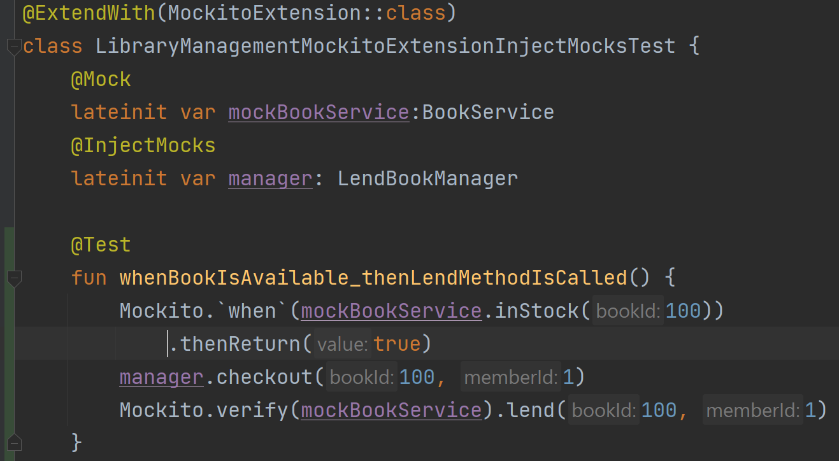
Example of Mock
Construct
Set behavior
Verify behavior

Slide 46
The Typical Usage Pattern
Setup mocks for all dependencies required by our units
– Either as part of setUp (@Before) or at the beginning of the test method
Set mocks to correctly handle interaction – Usually at the beginning of the test method
Call business logic under testing
Verify results & behavior (i.e. “side effects”)

Slide 47

Mockito
An open-source project providing an easy way to work
with Mock objects.
Can be freely downloaded from Google Code
http://code.google.com/p/mockito.
Released under the MIT License.
Notes:
https://www.baeldung.com/mockito-series

Slide 48
Mockito - Benefits
No need to write Mock objects by hand.
Simple “Set-Run-Verify” work model (as opposed to (expect/record-run-verify)
Refactoring-safe, no need to refactor Mock in case the
interface has changed.
Supports return values and Exceptions.
Flexible parameter handling in both set & verify
Single jar, easy setup
Easy to learn

Slide 49
Constructing Mocks
Option1: Use “mock” instead of “new”
Option2: Use @Mock annotation and AutoCloseable
val mockBookService = mock(BookService::class.java)
@Mock
lateinit var mockBookService:BookService
lateinit var closeable: AutoCloseable
lateinit var manager: LendBookManager
@BeforeEach
fun initService() {
closeable = MockitoAnnotations.openMocks(this)
manager = LendBookManager(mockBookService)
}

Slide 50
Constructing Mocks
Option3: Use @Mock annotation with MockExtension
@ExtendWith(MockitoExtension::class)
class LibraryManagementMockitoExtensionInjectMocksTest {
@Mock
lateinit var mockBookService:BookService
@InjectMocks
lateinit var manager: LendBookManager
}
Detail implementation at: https://github.com/doanpt/Junit-tutorial
from commit 17 to commit 22
Reference: https://www.baeldung.com/mockito-annotations

Slide 51
Setting up Mock Behavior
Mockito adds a functionality to a mock object using the methods when()
Examples:
Mockito.`when`(mockBookService.inStock(100))
.thenReturn(false)
Mockito.`when`(mockBookService.inStock(100))
.thenThrow(IllegalArgumentException::class.java)
...
Other Matchers:
anyInt, anyString,…
Custom matchers using hamcrest
Read more: https://www.baeldung.com/mockito-behavior

Slide 52
Verifing behavior
Mockito can ensure whether a mock method is being called with reequired arguments or not. It is done using the verify() method
verify(mockedList, times(1))[any()]
verify(mockBookService).lend(100, 1)
Read more: https://www.baeldung.com/mockito-verify
Notes:
https://www.baeldung.com/mockito-verify

Slide 53
Demo Mockito
Simple sample Junit with mockito Here
Use Mock annotation Here
Use Mock annoation and Inject dependencies Here
Use Mock annotation with Mockito extension Here
Use Mockito extension and Inject mocks annotation Here
Use Mockito extension to inject parameter Here

Slide 54
MockK library
https://www.baeldung.com/kotlin/mockk
https://github.com/doanpt/Junit-tutorial

Slide 55
References
https://github.com/doanpt/Junit-tutorial
https://programmingtechie.com/2020/12/26/junit-5-complete-tutorial/
https://shareprogramming.net/gioi-thieu-junit-5-java-testing-framework/
https://www.baeldung.com/kotlin/junit-5-kotlin
https://www.baeldung.com/mockito-series
https://www.arhohuttunen.com/junit-5-kotlin/
https://www.youtube.com/watch?v=flpmSXVTqBI
https://www.youtube.com/playlist?list=PLqq-6Pq4lTTa4ad5JISViSb2FVG8Vwa4o
https://udemy.com/course/junit5-for-beginners/
https://www.udemy.com/course/junitandmockitocrashcourse/
https://fpt-software.udemy.com/course/mockito-tutorial-with-junit-examples/

Slide 56
Assignment

Slide 57










The End

